Slide 1
BIA-658
LUNA CRASH ANALYSIS
Group 7
Amna Shamshad
Kanika Yadav
Sreelekha Kotla
Praveena Thalupunuri

Slide 2
Problem Statement
“To what extent can Luna crash be detected by exploring the network properties of Terra network?”
We have Terra network data that contains transactions for stable terra coins that includes 6 stable coins
USDT
USDC
DAI
UST
PAX
WLUNA.
We have explored the network properties for Luna network to answer the above question.

Slide 3
Network Construction
The data shows the amount of stablecoin transmitted between different users. Each user has a unique address.
Each coin has a unique contract address
The initial dataset comprised over 70 million transactions (till November) out of which we have worked on data from Friday, April 1, 2022 11:10:21 AM GMT) to Monday, August 31, 2022 12:00 AM GMT).
The Luna crash occurred on 12th of May, 2022 when its price reached 0 USD.
We also have the closing daily price data for each coin in a separate file
The time data was in seconds (epochs) and was converted to proper datetime format using python.
Crypto users are nodes and transactions are the edges.
The network was constructed from an edge list that consists of 2 columns of nodes (from_address and to_address) and the weight of edge that corresponds to the number of transactions between the two users.

Slide 4
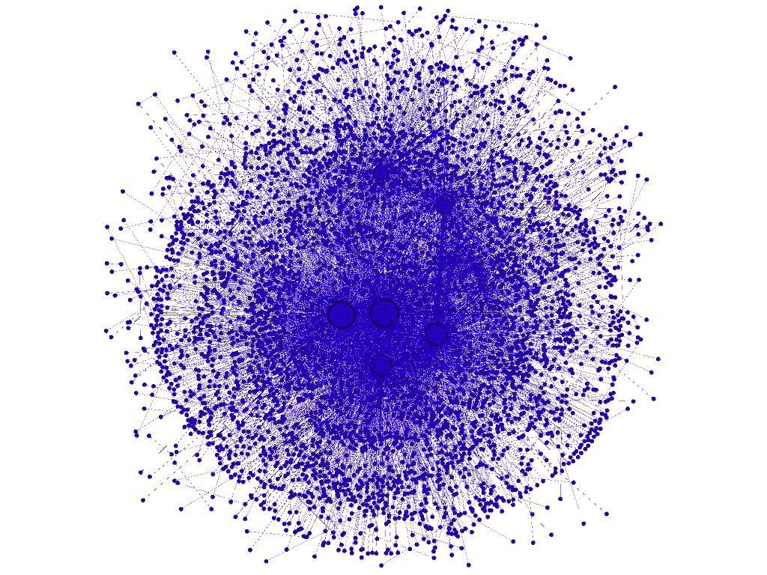
Data Visualization
We plotted April’s data for WLUNA to get a better understanding of the network and the following output was generated as a consequence. Node size corresponds to the degree of node. When the size of the node increases, the degree also increases.

Slide 5
Data Analysis
We have used various social network concepts to analyze our dataset. Following approaches have been used to study the social network to detect and analyze Luna crash.
Graphical analysis of network for various months before and after Luna crash
Comparison of transitivity, reciprocity and centralization prior and post crash
Correlation between the six crypto coins
Checking for homophily effects in social network prior crash
Comparison of network modularity before and after crash
Comparison of price stats for various month

Slide 6
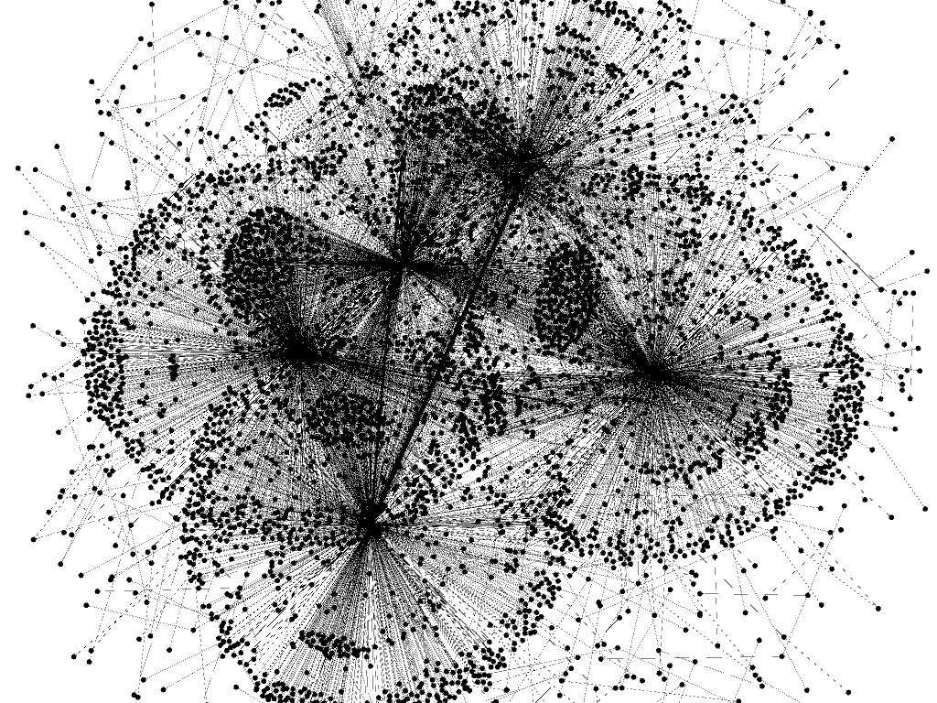

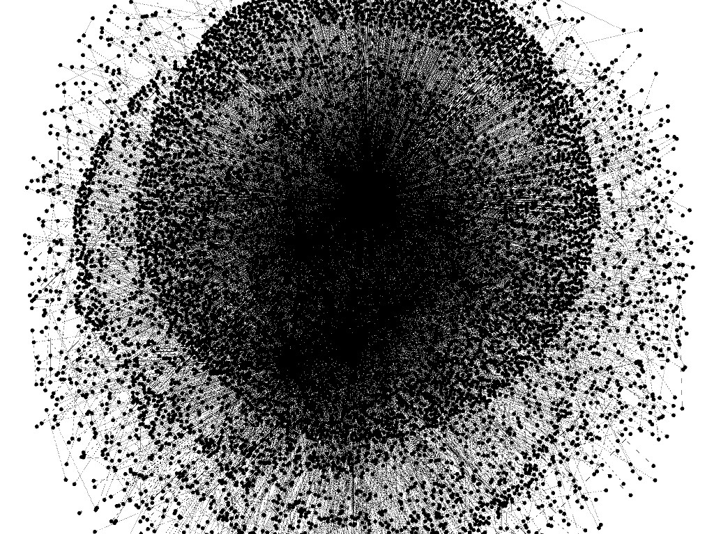
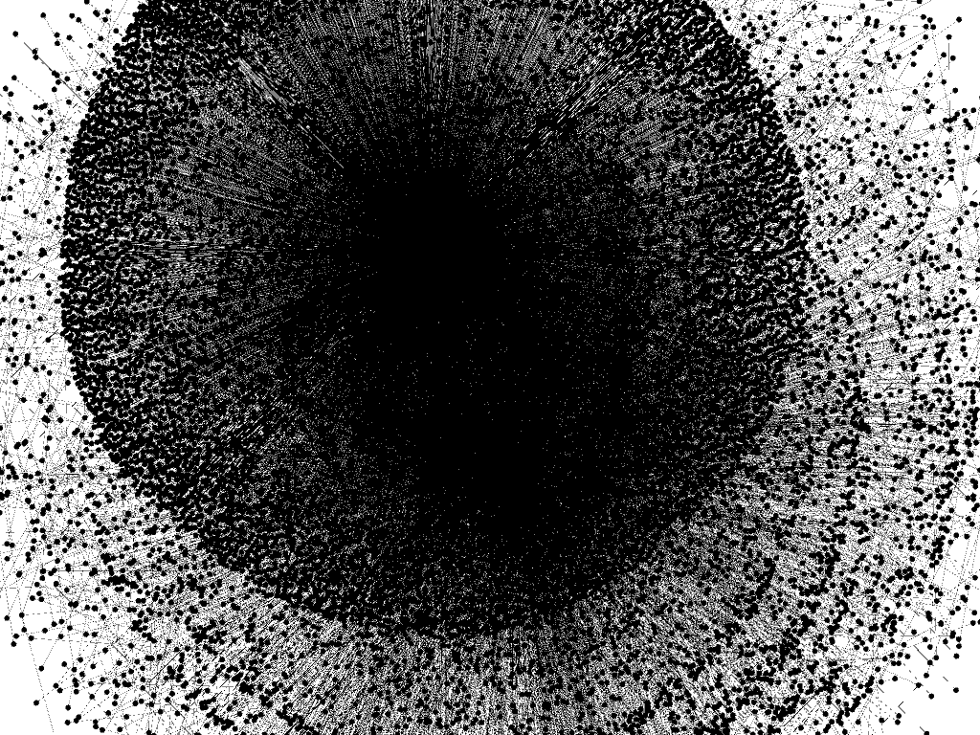
Comparison of Networks Through Graphs
April 2022
Layout: Yifan Hu (Gephi)
May 2022
Layout: Yifan Hu (Gephi)
June 2022
Layout: Yifan Hu (Gephi)
July 2022
Layout: Yifan Hu (Gephi)

Slide 7
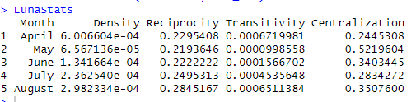
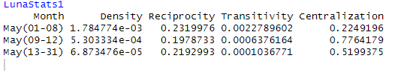
Comparison of Transitivity, Centralization, Reciprocity

Slide 8
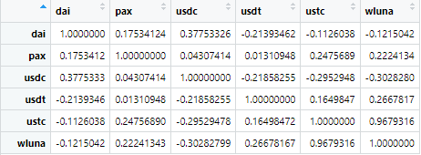
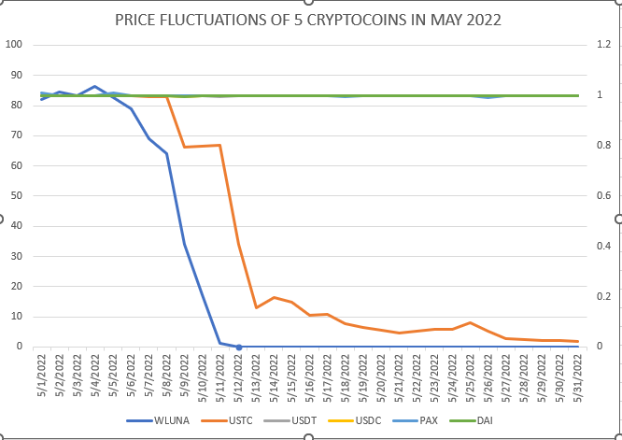
Correlation Between the Six Crypto Coins

Slide 9
Homophily Effects in Social Network Prior Crash
No significance results for homophily (Negative Infinity). Nodes with higher connections were not more likely be connected to each other prior crash
Density of the network was significant prior crash

Slide 10
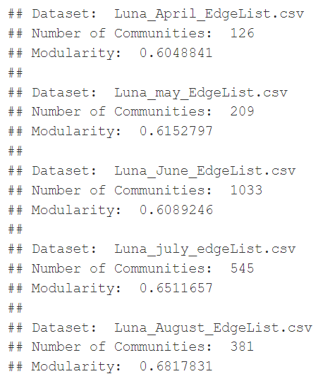
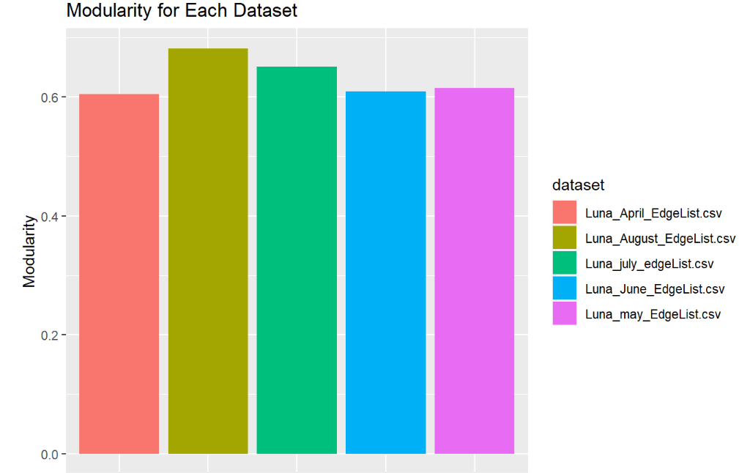
Network Modularity

Slide 11
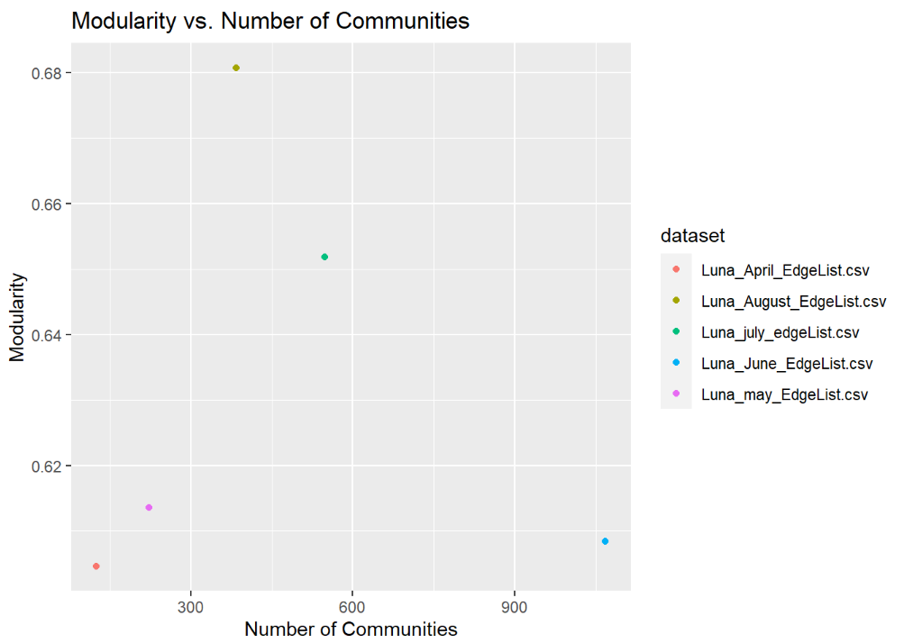
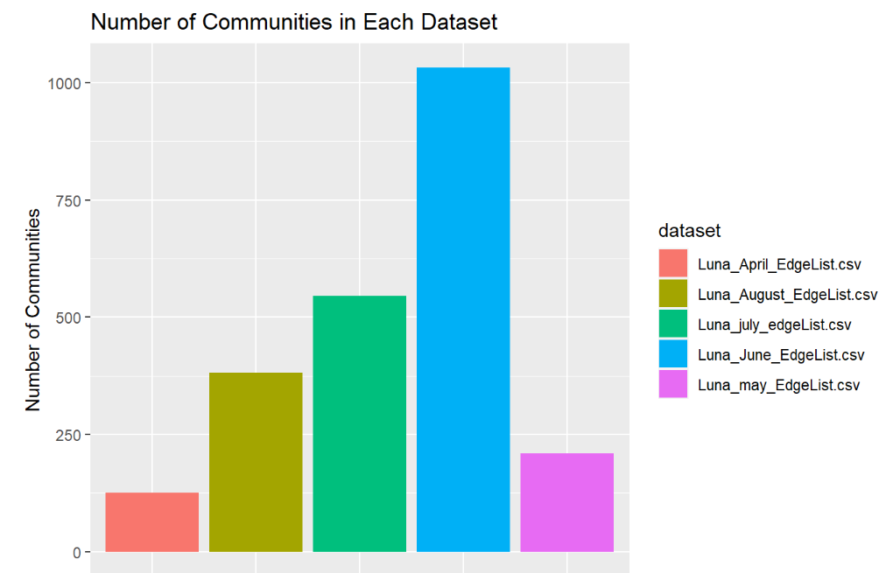
Modularity & Communities Comparison
## The output indicates that the number of communities detected in the Luna dataset varies widely across the different months, ranging from 123 in April to 1066 in June. Similarly, the modularity values also show some variation, with the highest value of 0.6813266 in August and the lowest of 0.6046697 in April.
## It is interesting to note that the number of communities detected in May, the month when the Luna crash happened, is higher than the preceding month (April) and the following month (June). However, the modularity value for May is not significantly different from the other months. This suggests that there may not be a strong relationship between the number of communities detected and the occurrence of the crash.
## It is also worth noting that the modularity values for all the months are relatively high.

Slide 12
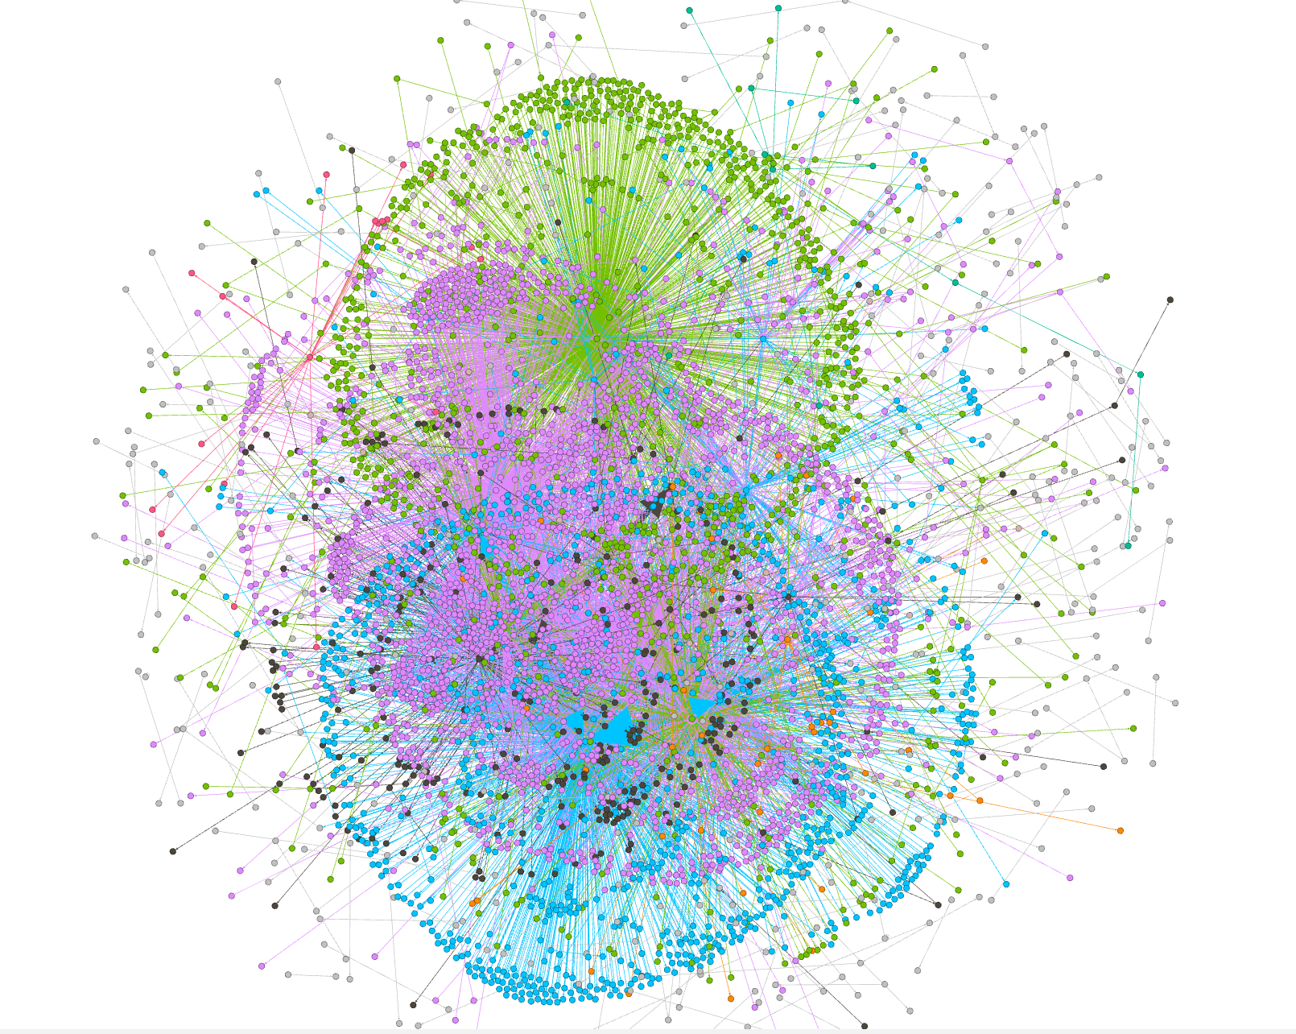

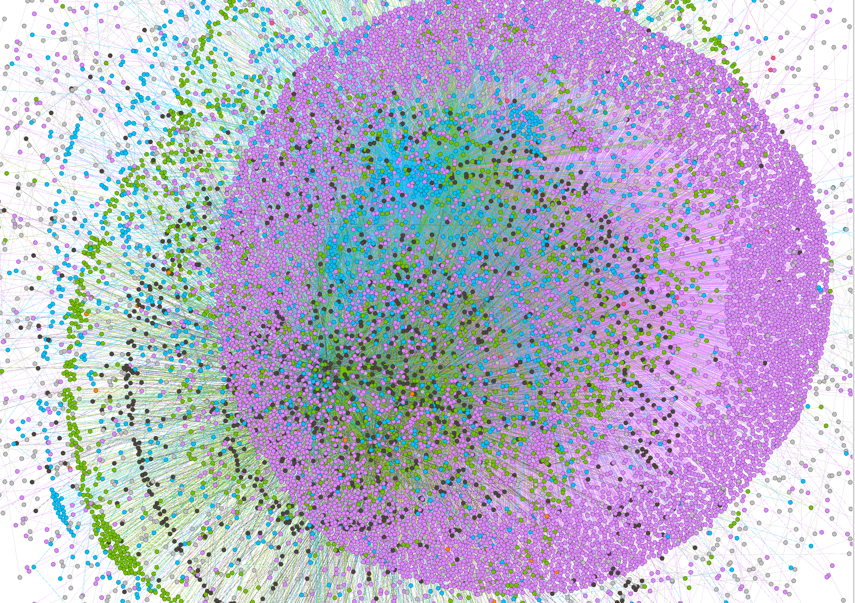
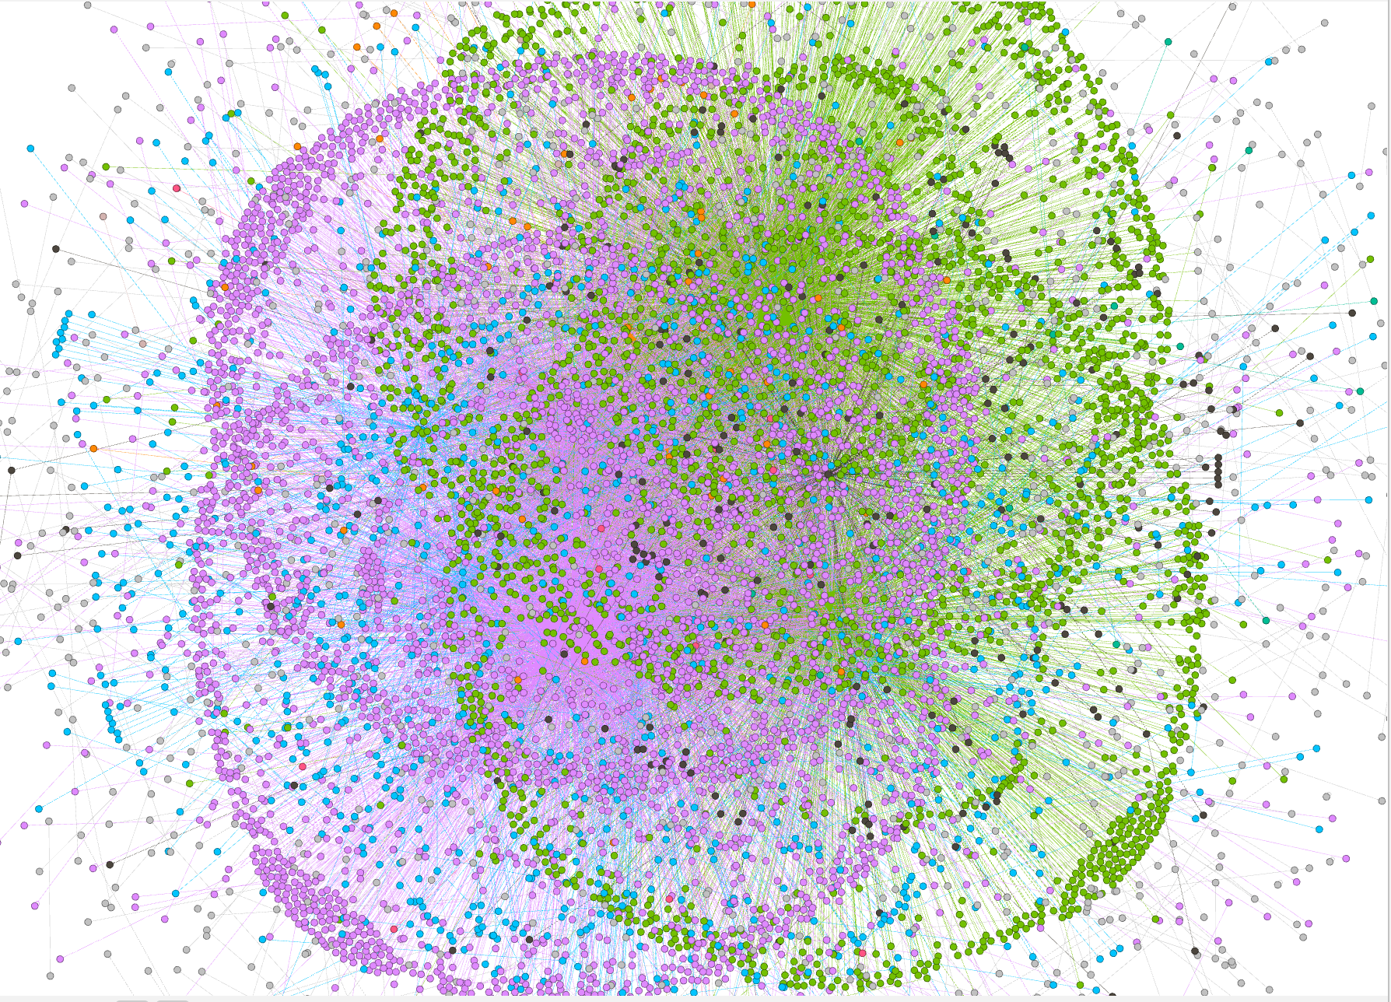
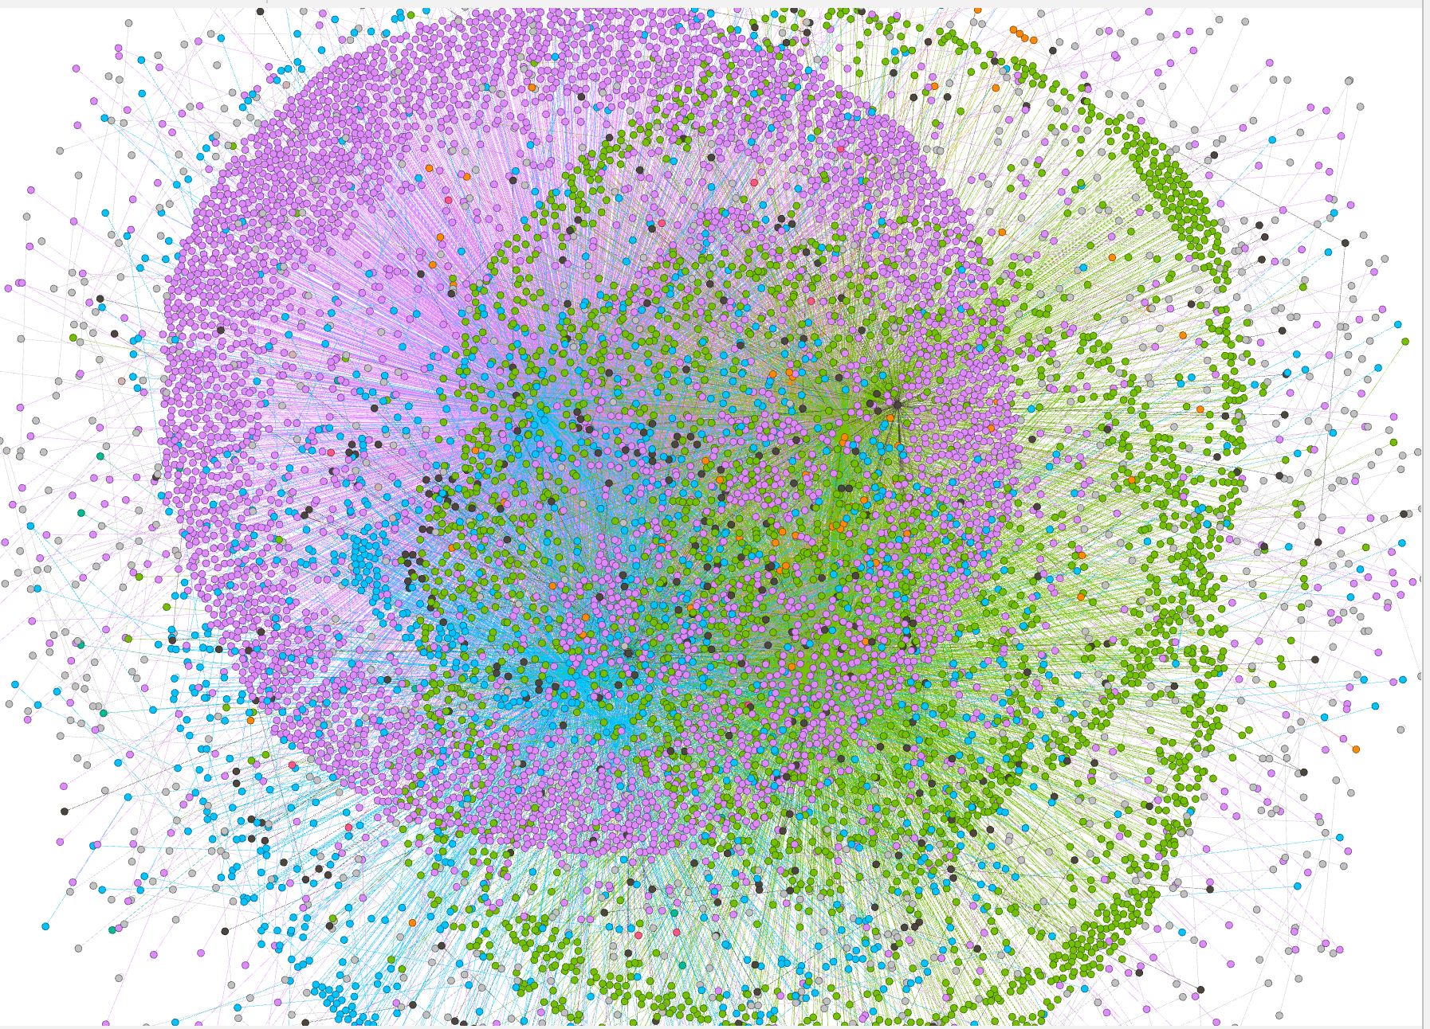
Network Visualization - Modularity
April
May
June
July
August

Slide 13
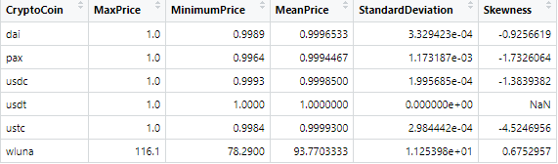
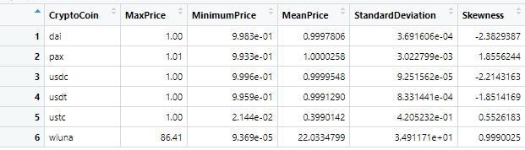
Comparison of Stats for Various Months
April 2022
May 2022

Slide 14
Findings
A decreasing network density, higher centralization and higher transitivity can be a sign of an upcoming crash creating a “domino effect” in the network.
The network is most centralized when Luna price reaches close to zero causing a significant fraction of transactions to be doe by a group of users. With key players in the network coming together, the network, insider trading starts with groups of individuals. This panic selling rensults in drastic decrease in price of a coin.
Modularity of network dropped to lowest in month of May indicating high integration among nodes right during Luna crash whereas it is observed modularity was highest in month of April to have a possibility of crash soon
In future if the value of a USTC will increase, investors can also think about buying WLUNA to diversify their holdings and possibly boost returns because of high correlation. Similarly, a decrease in USTC price can account for a further decrease in Luna price.

Slide 15
Thank you! :)
Questions?

